Slide 1
138/69 kV Substation Design
By: Kaitlyn Ziska, Brian Mace ,Brandon Kaas, Justin Fischbach, Robert Huschak, and Salvador Salazar-Garcia
Burns & McDonnell
Prof. McCalley
http://sdmay20-15.sd.ece.iastate.edu/

Slide 2
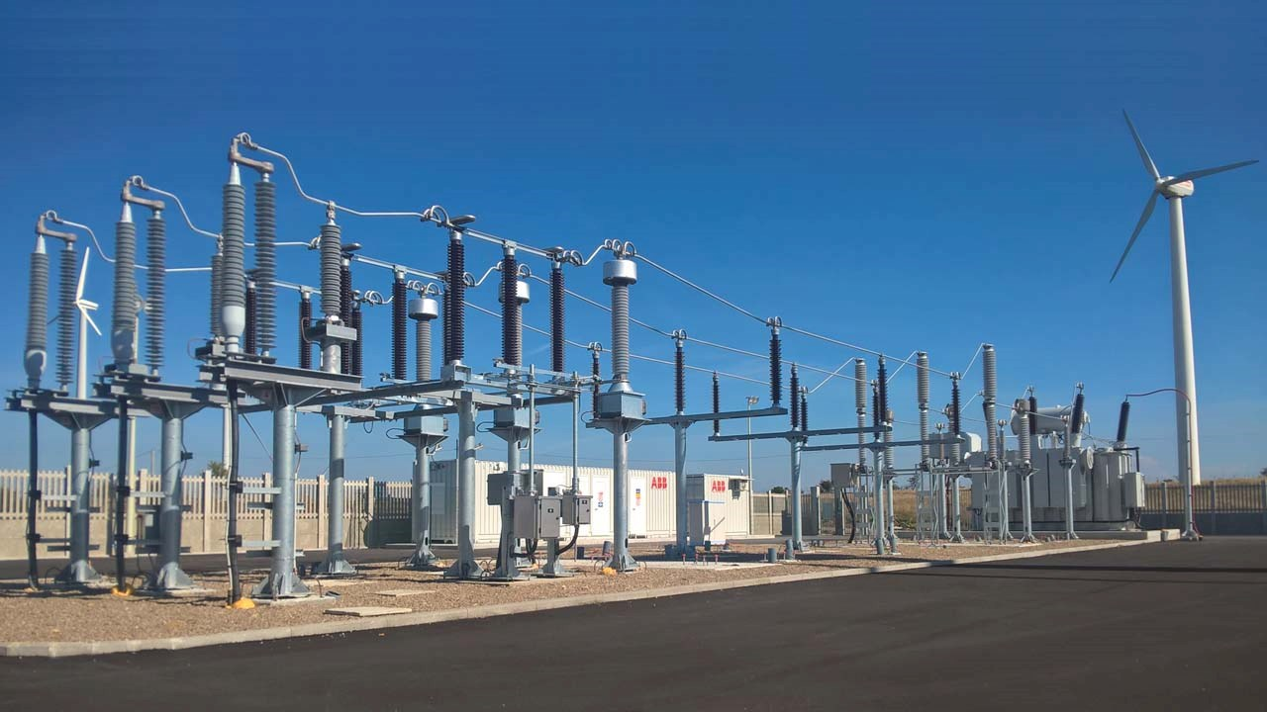
Project Vision:
Substation Location
Project Purpose
Project Goals

Slide 3
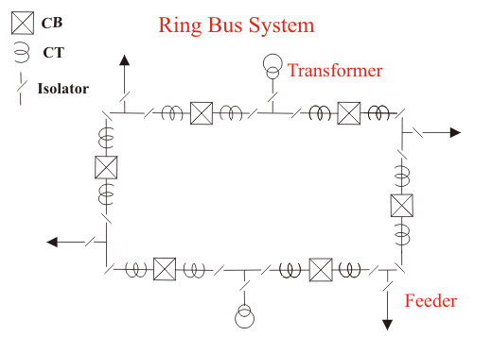
Project
Concept:

Slide 4
Cost Estimation & Purpose
Cost component was not included in the scope
Would be accounted for in actual design process
Substation designed with cost in mind

Slide 5
Functional Requirements:
Potential Risks & Mitigation:
One-Line Diagram
Plan Views
Sectional Views
Wiring and Schematics
Lightning Study
AC Analysis
DC Analysis
Grounding Study

Slide 6
Project Plan – Schedule/Milestones
Separated into 6 major tasks
One Line - derived from Scope Document
Plan View - derived from One Line
Lightning Study - derived from Plan View
AC Study - derived from Plan View
DC Study - derived from Plan View
Schematics – derived from Protection & Controls Document (P&C)
Wiring - derived from Schematics and P&C Document
Milestones based on these tasks discussed with Burns and McDonnell

Slide 7
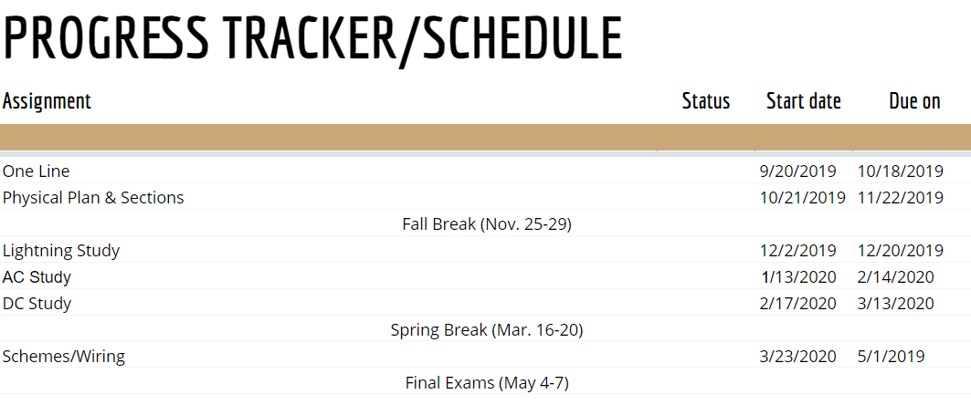
Project Plan – Schedule/Milestones

Slide 8
AUTOCAD
Used AutoCAD 2020
Industry Standard

Slide 9
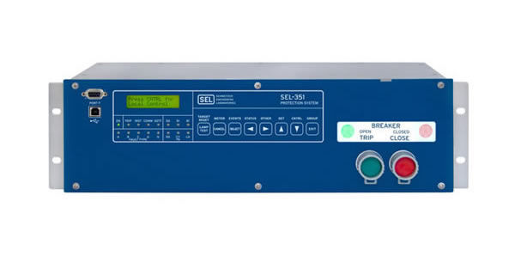
System Design
3 Breaker-Ring bus configuration
High side: 138kV
Low side: 69kV
3 line exits, 1 transformer
Relaying for protection

Slide 10
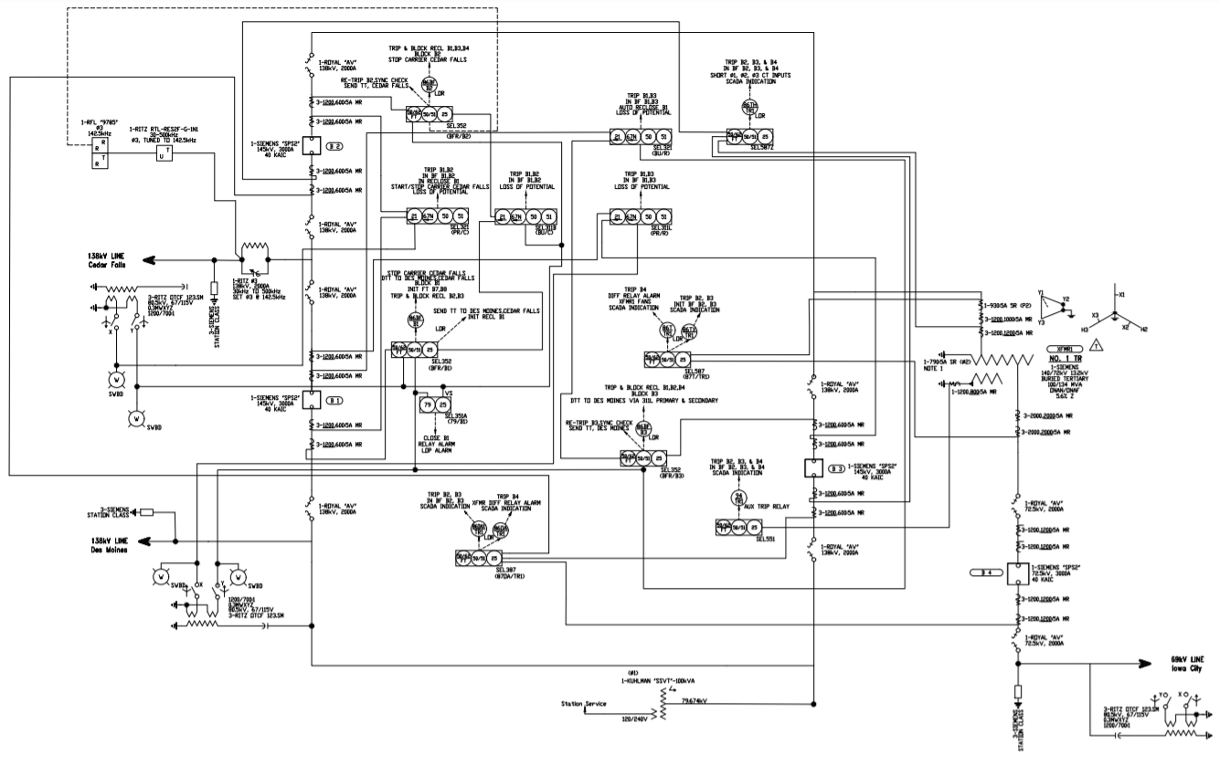
Design Concepts
One Line Diagram

Slide 11
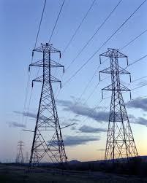
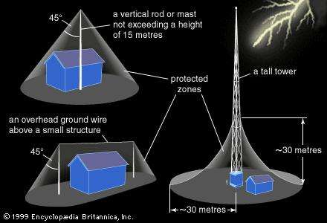
System Design: Physical
Breakers isolated by disconnect switches
Space allotment for future expansion
Bus support
Bus-Ring tie in
Lightning Protection

Slide 12
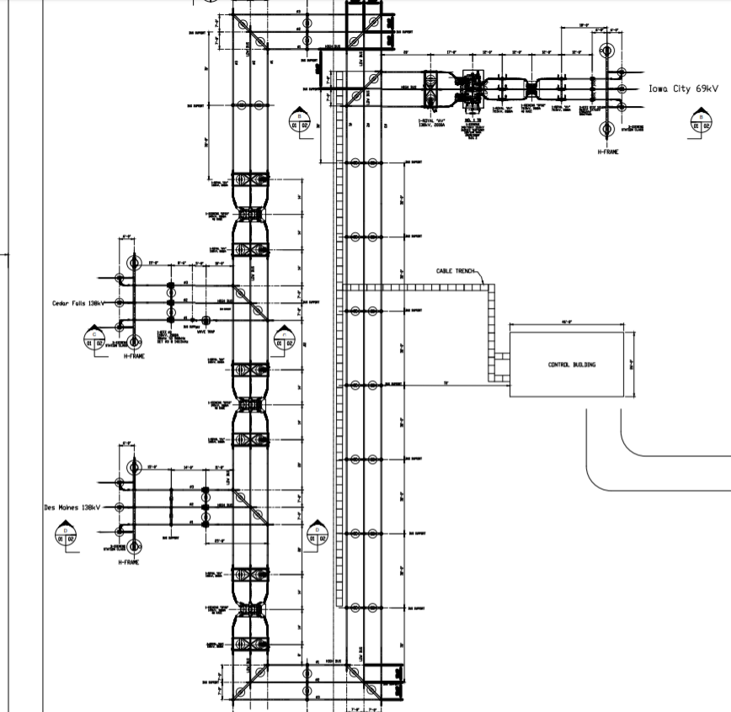
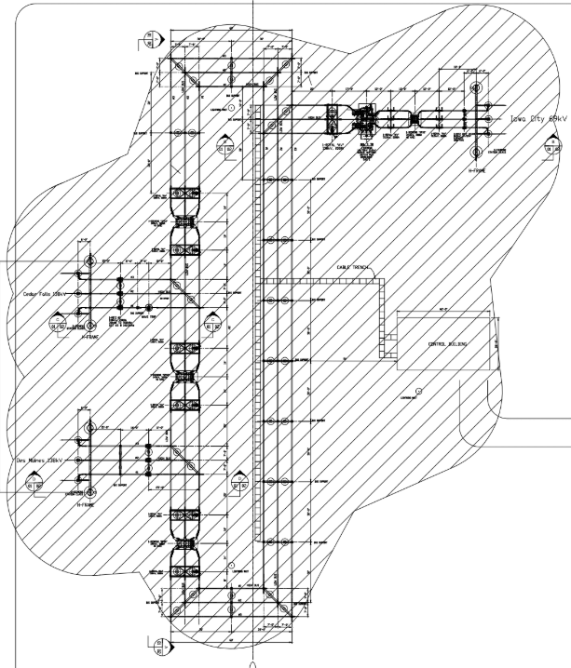
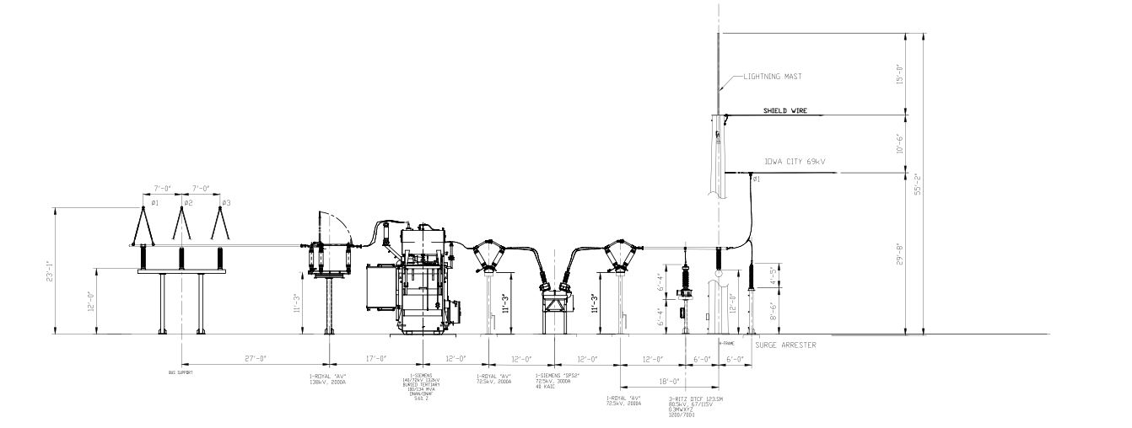

Slide 13
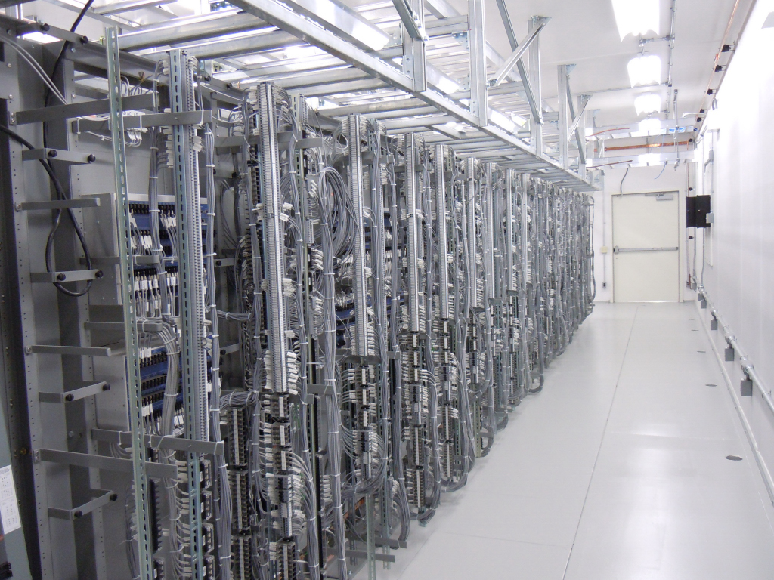
System Design: Protection and Controls
AC/DC study
Schematics
Wiring

Slide 14
AC & DC Studies
Calculation for system SSVT
Includes worst case scenario of summer and winter conditions
Protection for power loss at substation
Calculations performed to sustain system for 8 hrs. after loss of power

Slide 15
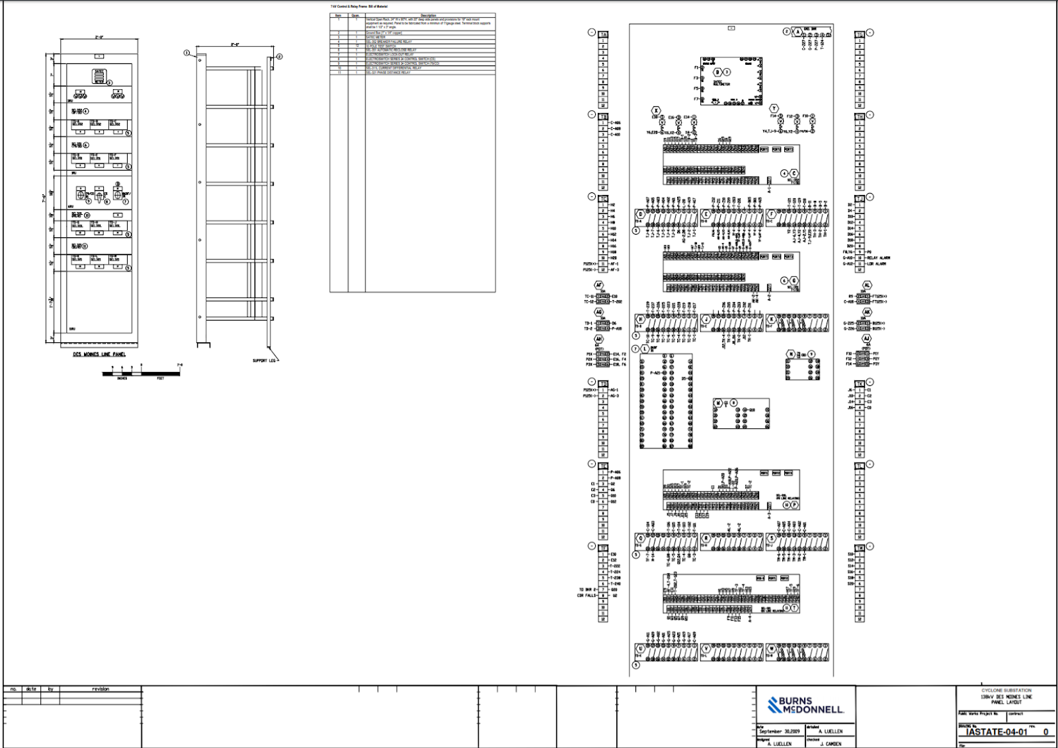
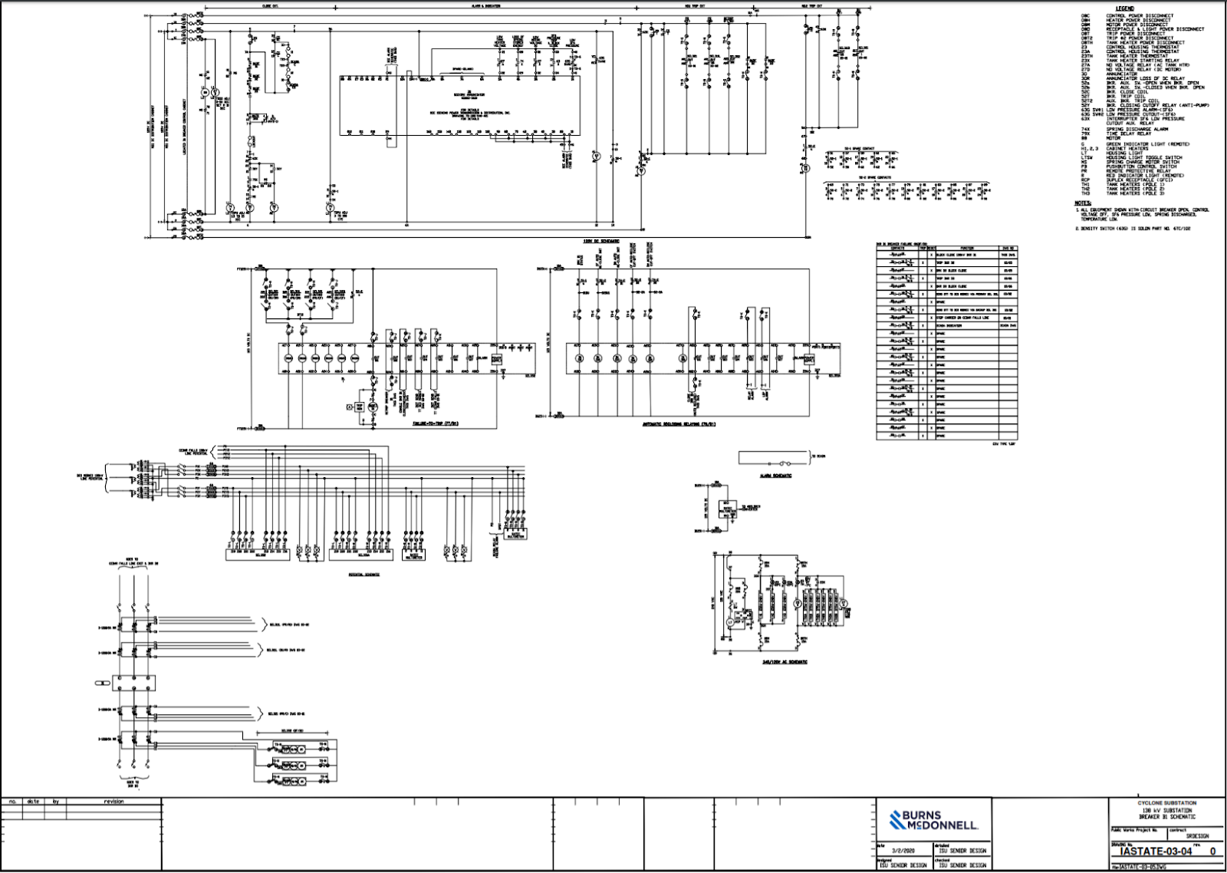
Schematics & Wiring Diagrams

Slide 16
Engineering Standards and Design Practices
Burns & McDonnell Scope
Burns & McDonnell Example Cells and Drawings
IEEE Standards
IEEE 485-2010 Recommended Practice for Sizing Lead-Acid Batteries for Stationary Applications
IEEE 998-2012I EEE Guide for Direct Lightning Stroke Shielding of Substations

Slide 17
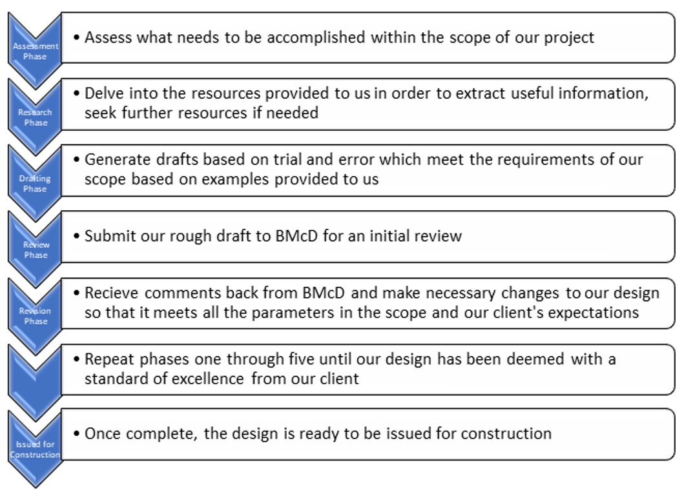
System level testing/Acceptance testing

Slide 18
Prototyping One Line
Phase 1
Initial One-Line

Slide 19
Prototyping - Plan Views
Revision 1
Spacing Concerns forced changes to the One-Line
Revision 2
Needed more Dimensions and added a Drive Path around substation
Revision 3
Final Submission before starting lightning study
Adjusted Section Cut placement

Slide 20
Prototyping - Section Cuts
Revision 1
Initial Design from plan view
Missing Dimensions and bus supports
Revision 2
Added Needed structures
Still needs more dimensions
Change section cut
Revision 3
Changed section view to other line exit
Added Shield Wire and equipment labels

Slide 21
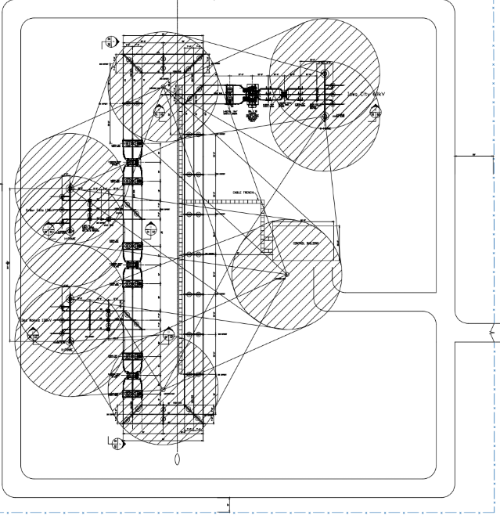
Lightning Study

Slide 22
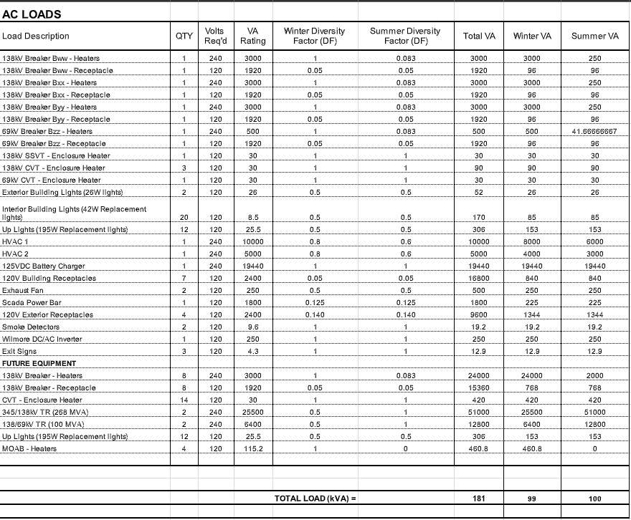
AC Study
Component Power
Breakdown
Summer/Winter

Slide 23
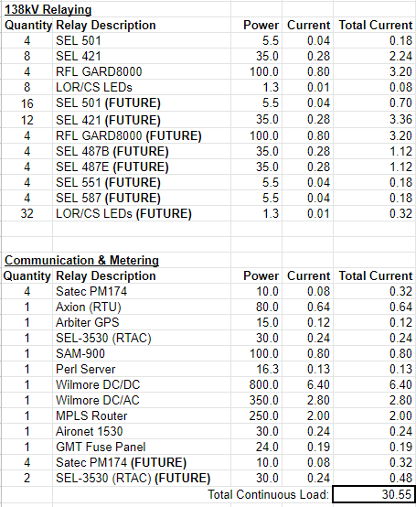
DC Study
Break down worst case failure
Time based loads
Calculate battery size and charger

Slide 24
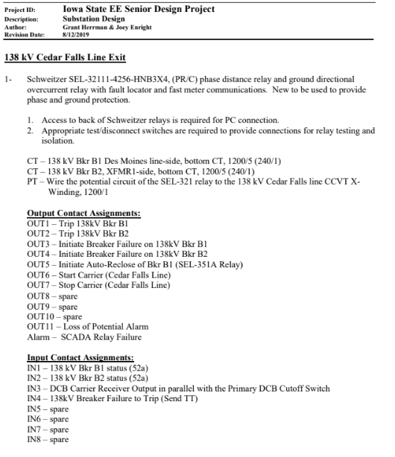
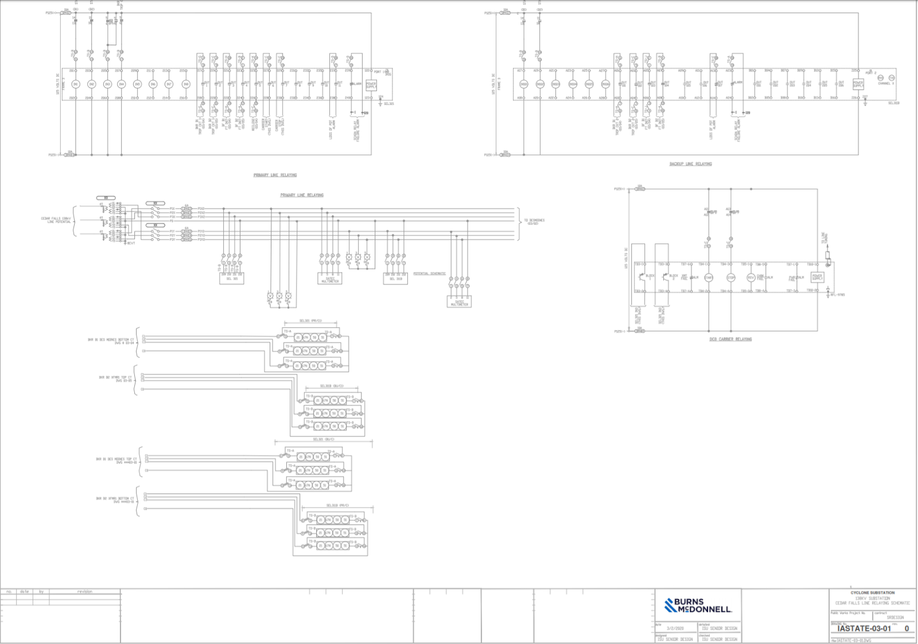
Prototyping-System Schematics
Relay Protection Schematic

Slide 25
Prototyping-Wiring
Due to current situation time did not allow for a complete system design

Slide 26
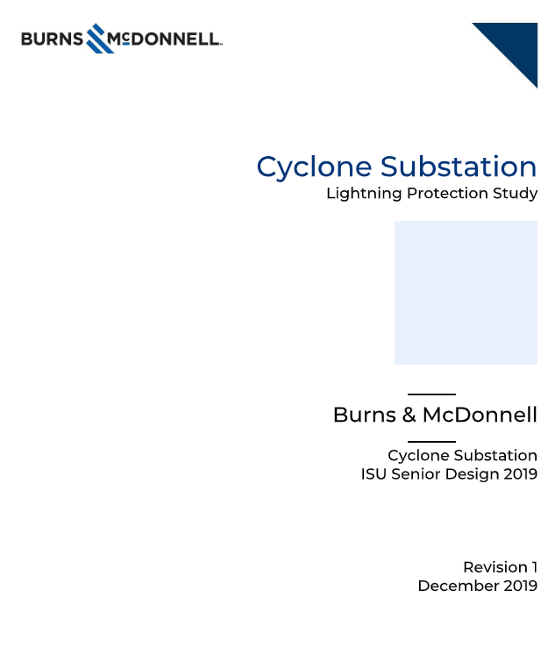
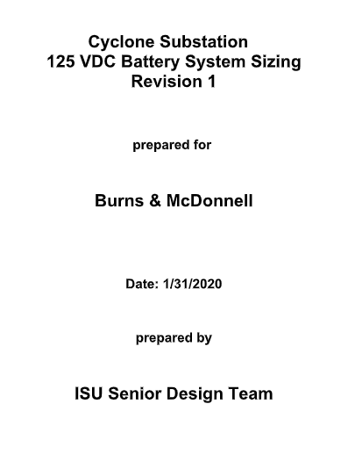
Final Submission
10 drawing files
1-One Line
1-Plan View
1-Section Cut
1-Lightning Study
5-Schematics
1-Panel Wiring
2 reports
Lightning & DC studies

Slide 27
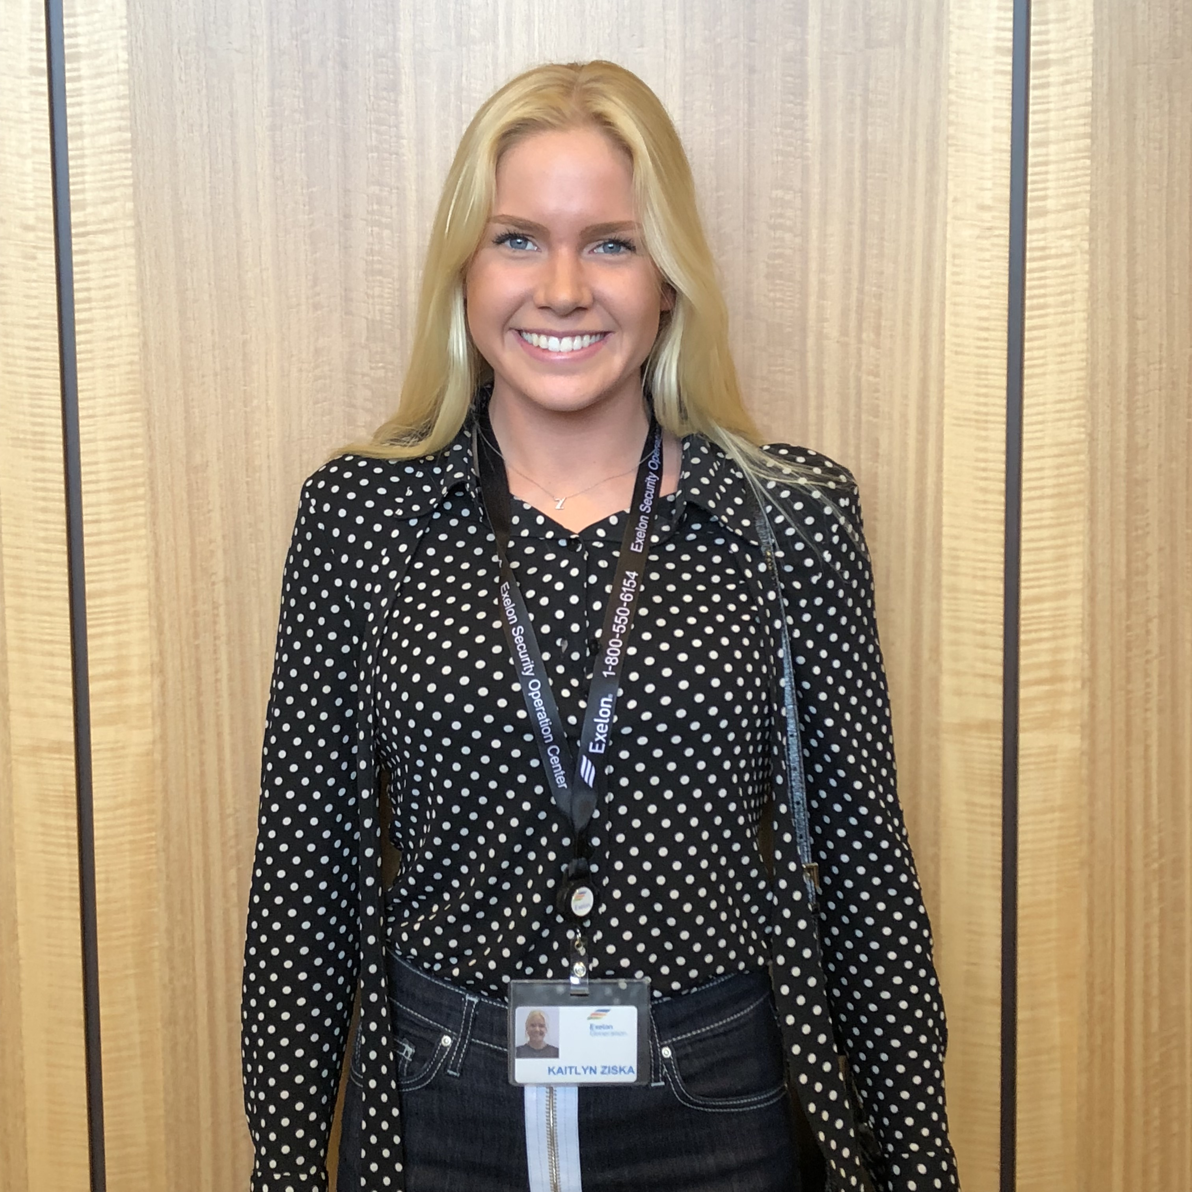
Our Roles & The Future
⬅
Robert Huschak – Report Manager
Justin Fischbach – Test Engineer
➔
⬅
Kaitlyn Ziska – Professor Client Liaison
➔
Brian Mace – Chief Engineer
⬅
Salvador Salazar – Meeting Facilitator
➔
Brandon Kaas – Scribe

