Slide 1
138/69 kV Substation Design
By: Kaitlyn Ziska, Brian Mace ,Brandon Kaas, Justin Fischbach, Robert Huschak, and Salvador Salazar-Garcia
Burns & McDonnell
Prof. McCalley

Slide 2
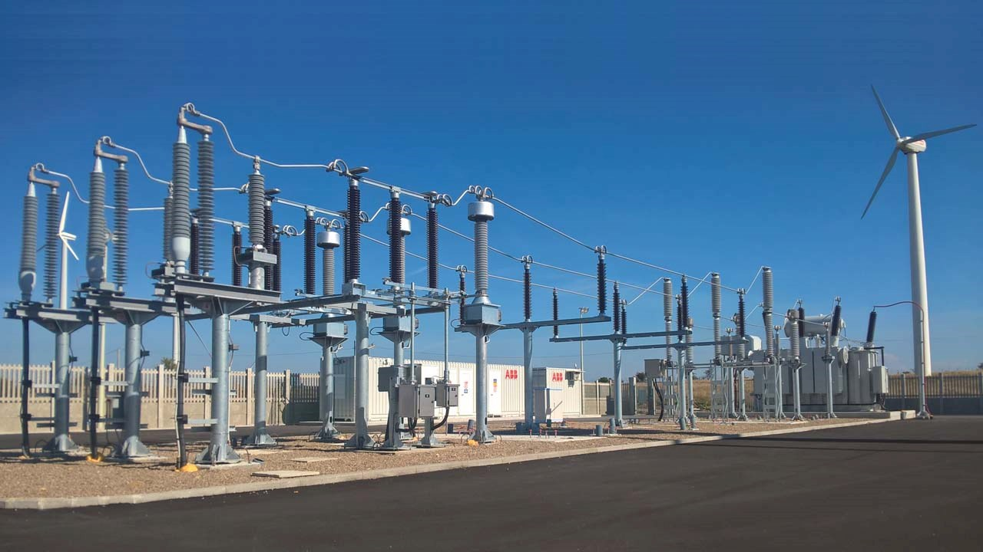
Project Vision:
Substation Location
Project Purpose
Project Goals

Slide 3
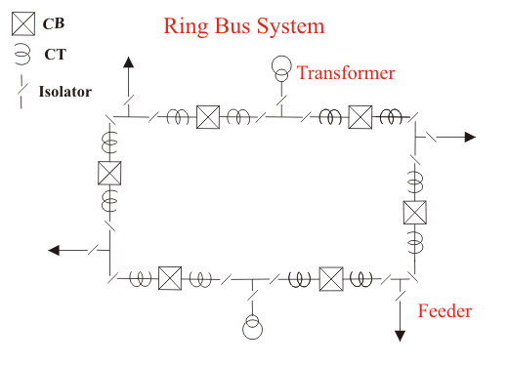
Project
Concept:

Slide 4
Functional Requirements:
Non-Functional Requirements:
One-Line Diagram
Plan Views
Sectional Views
Wiring and Schematics
Lightning Study
AC Analysis
DC Analysis
Grounding Study

Slide 5
Project Plan – Schedule/Milestones
Separated into 6 major tasks
One Line - derived from Scope Document
Plan View - derived from One Line
Lightning Study - derived from Plan View
AC Study - derived from Plan View
DC Study - derived from Plan View
Wiring - derived from One Line
Milestones based on these tasks discussed with Burns and McDonnell

Slide 6
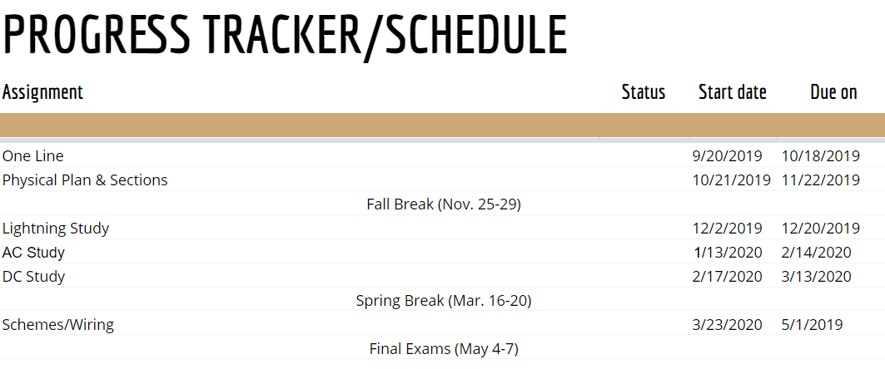
Project Plan – Schedule/Milestones

Slide 7
Project Plan – Schedule/Milestones

Slide 8
Design Process
Burns & McDonnell Scope
Burns & McDonnell Example Cells and Drawings
IEEE Standards

Slide 9
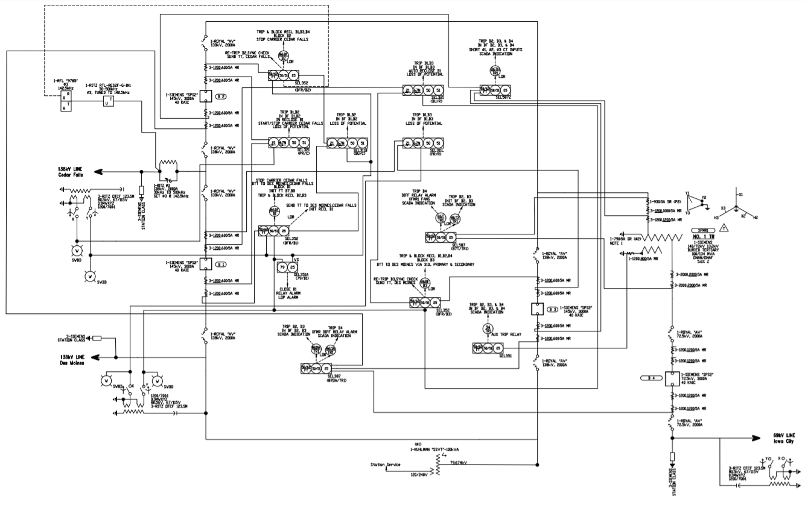
Design Concepts
One Line Diagram

Slide 10
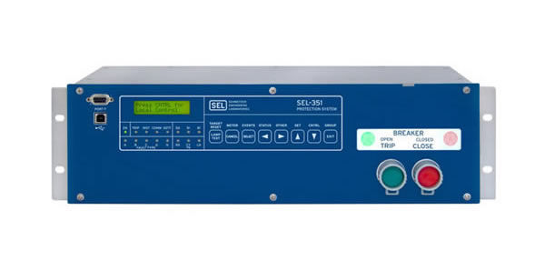
System Design
3 Breaker-Ring bus configuration
High side: 138kV
Low side: 69kV
3 line exits, 1 transformer
Relaying for protection

Slide 12
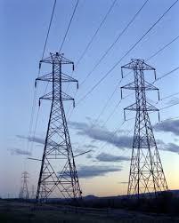
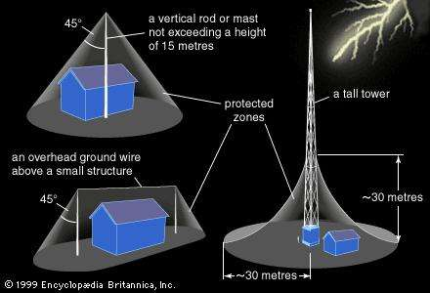
System Design: Physical
Breakers isolated by disconnect switches
Space allotment for future expansion
Bus support
Bus-Ring tie in
Lightning Protection

Slide 13
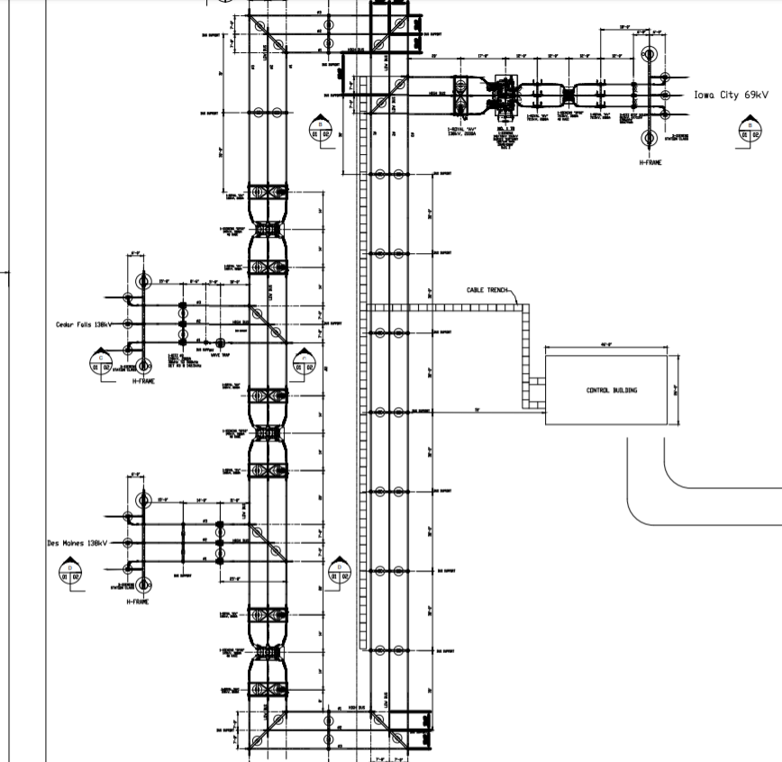
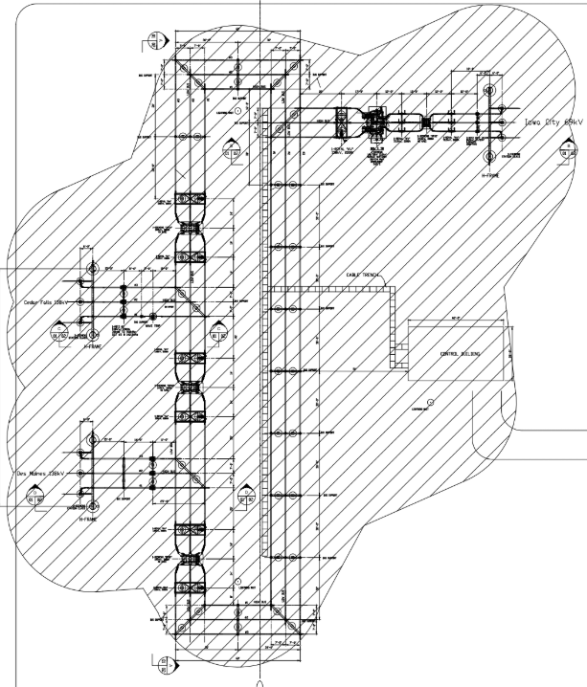
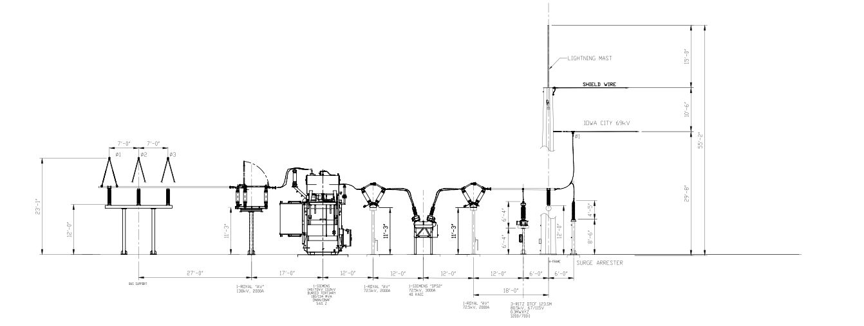

Slide 14
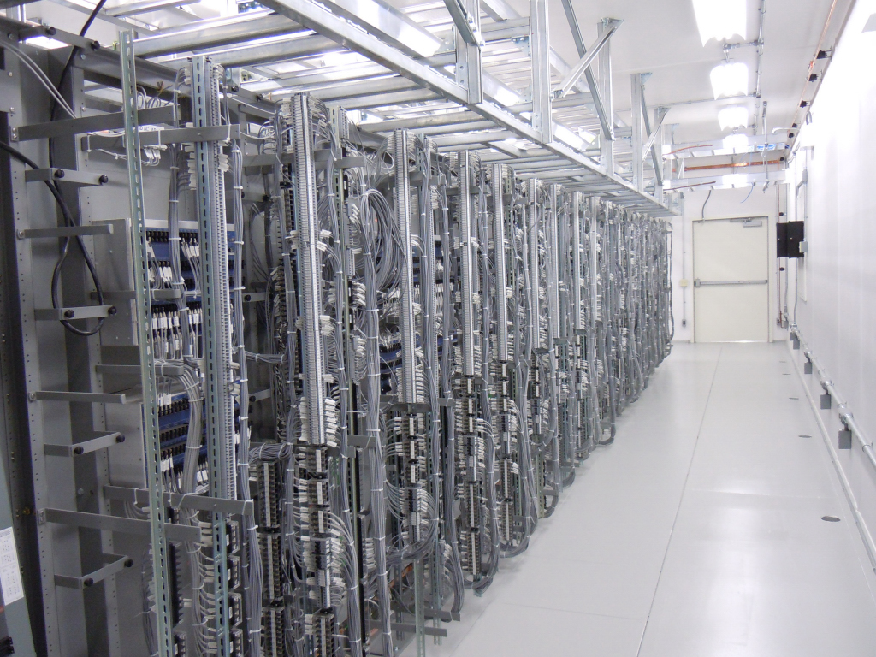
System Design: Future Plans
AC/DC study
Schematics
Wiring

Slide 15
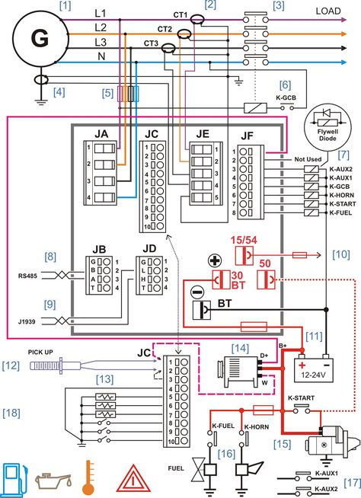
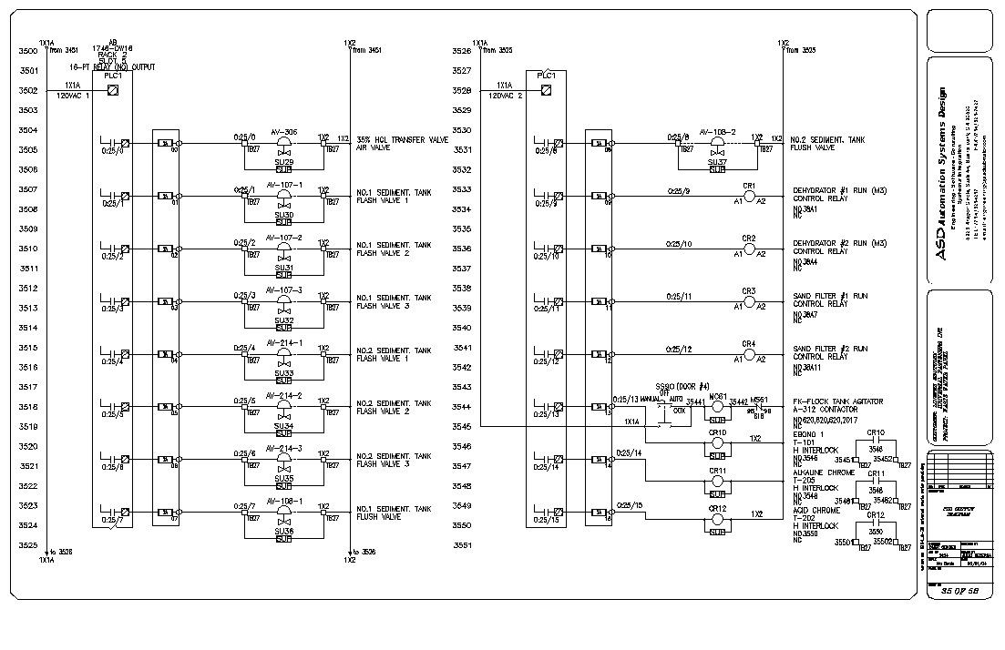

Slide 16
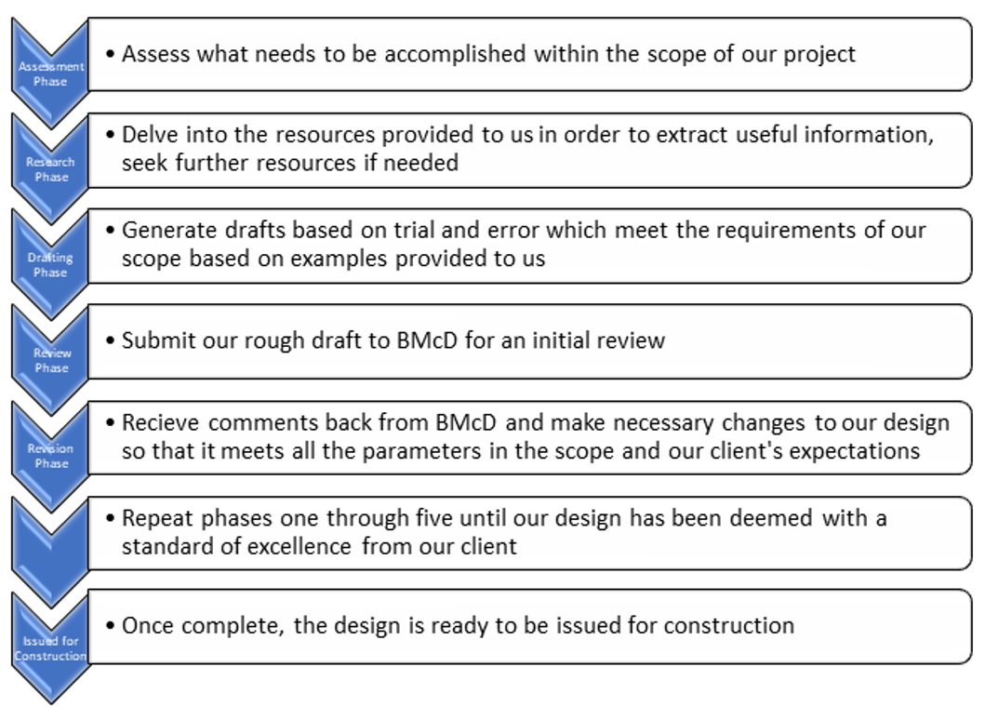
System level testing/Acceptance testing

Slide 17
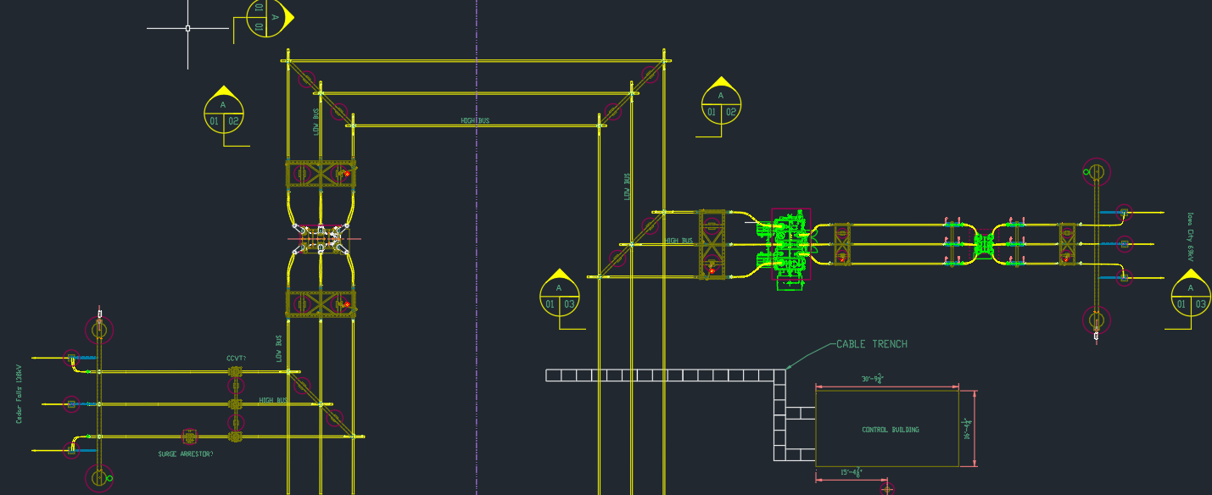
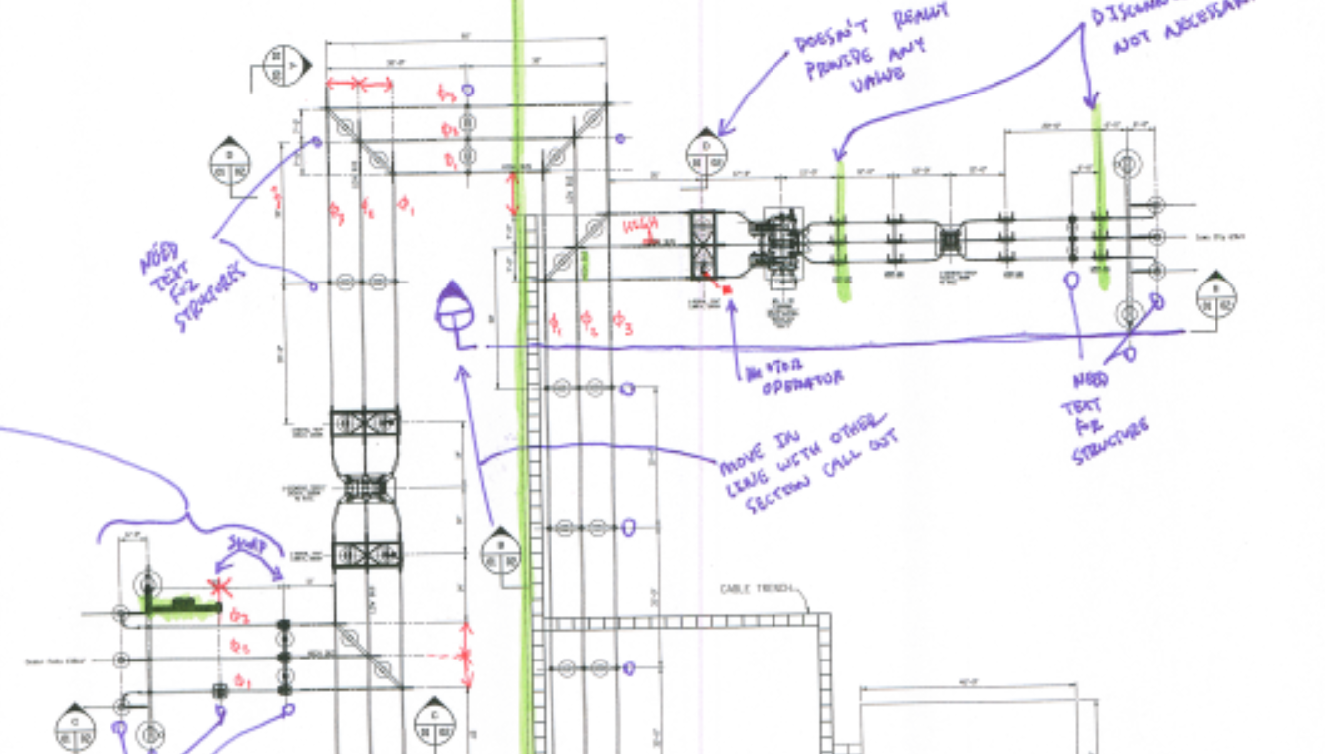
Test Plan
Revision Process

Slide 18
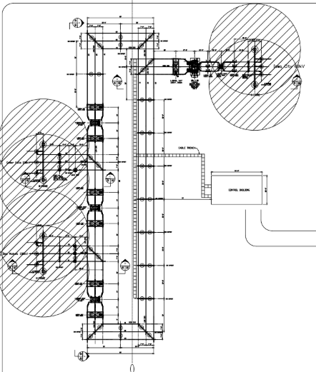
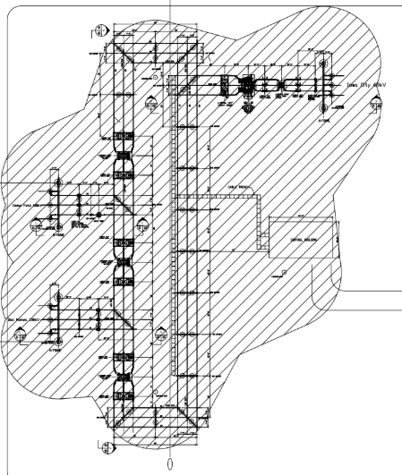
Component/Unit testing
Lightning Study
Following IEEE 998-2012

Slide 19
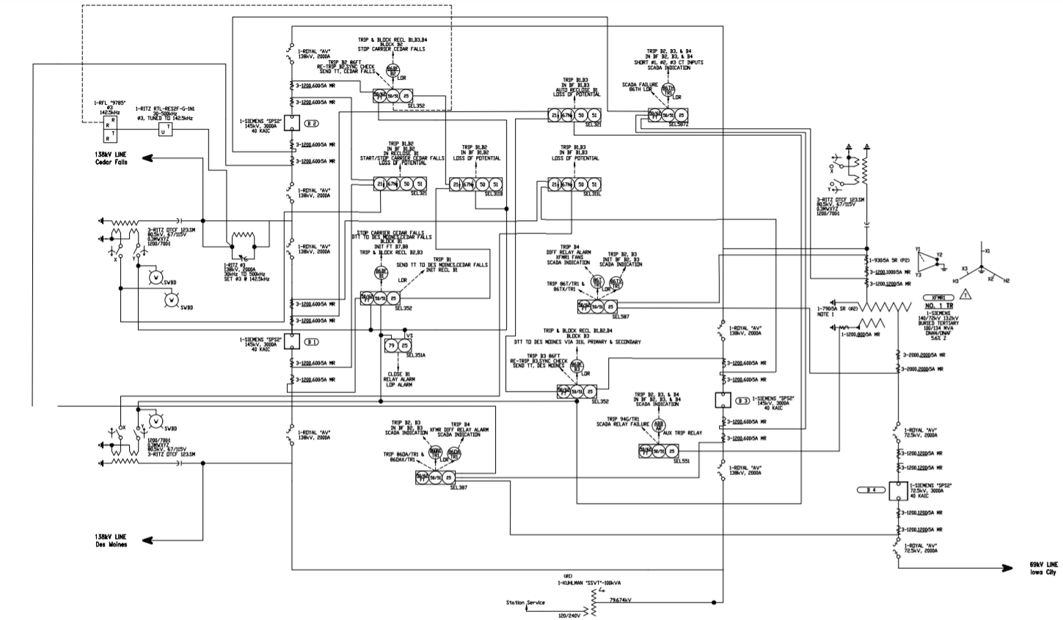
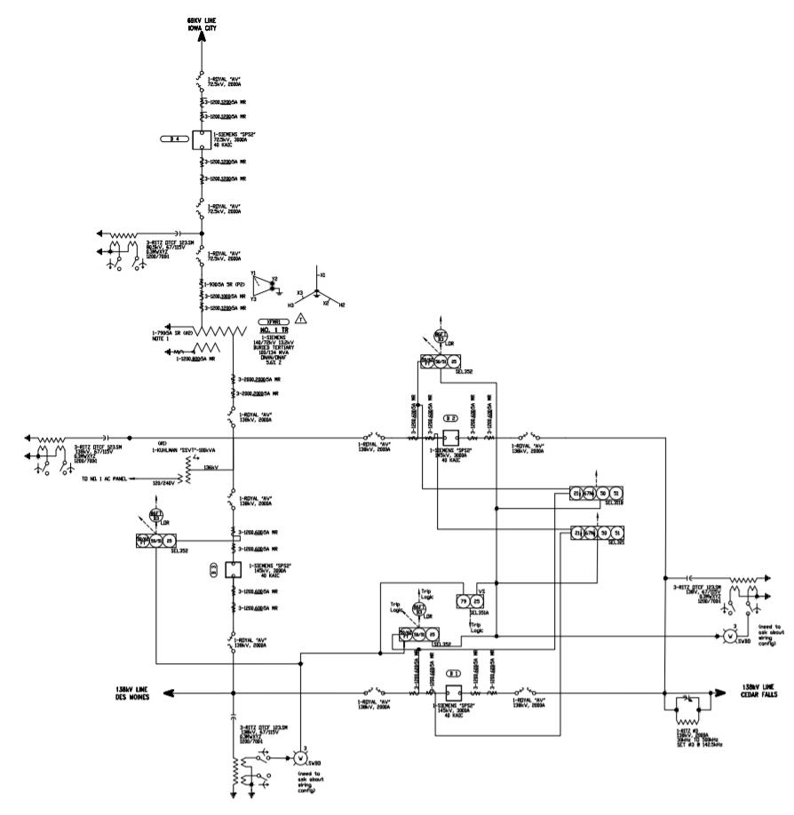
Prototyping - One Line
Phase 3
Final Revision
Phase 2
First Revision
Phase 1
Initial One-Line

Slide 20
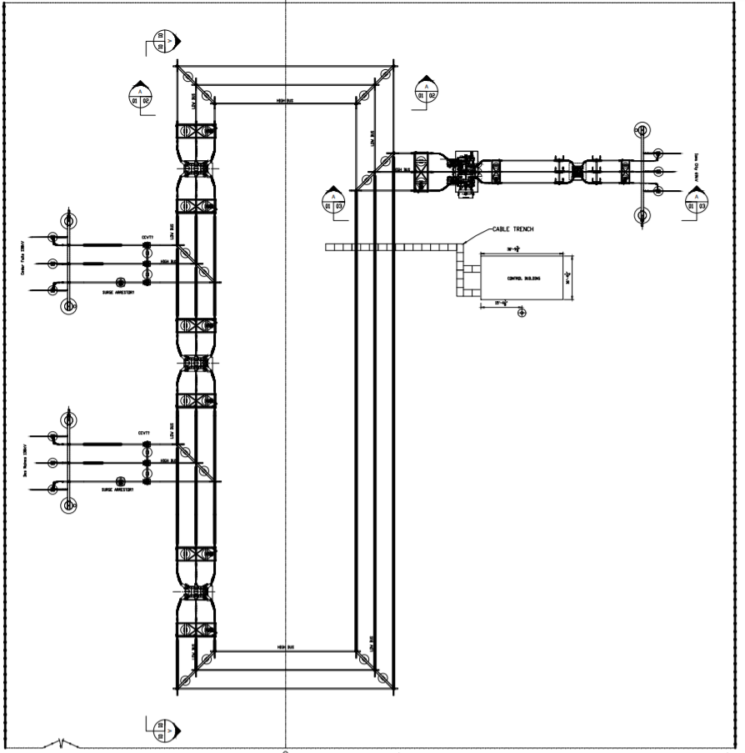
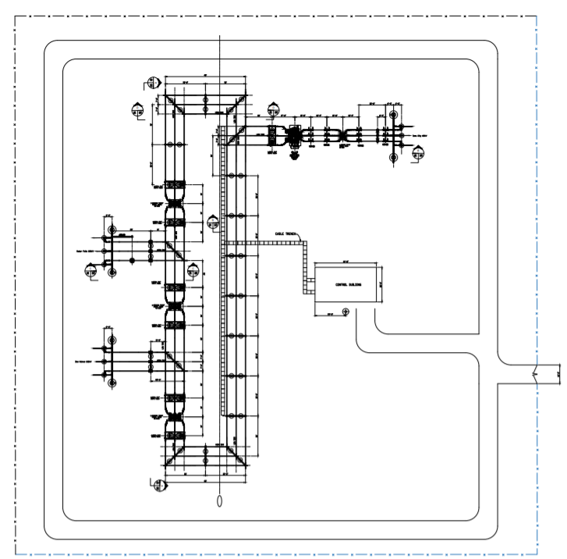
Prototyping - Plan Views
Revision 1
Spacing Concerns forced changes to the One-Line
Revision 2
Needed more Dimensions and added a Drive Path around substation
Revision 3
Final Submission before starting lightning study
Adjusted Section Cut placement

Slide 21
Prototyping - Section Cuts
Revision 1
Initial Design from plan view
Missing Dimensions and bus supports
Revision 2
Added Needed structures
Still needs more dimensions
Change section cut
Revision 3
Changed section view to other line exit
Added Shield Wire and equipment labels

Slide 22
Roles
Kaitlyn Ziska – Professor Client Liaison
Brian Mace – Chief Engineer
Brandon Kaas – Scribe
Salvador Salazar – Meeting Facilitator
Justin Fischbach – Test Engineer
Robert Huschak – Report Manager

Slide 23
What is Next?
AC-DC Studies
Wiring and Schematics

